Slide 1
RoboDoc: IMU Motor Function Evaluation
Steven R Parker, Daniel Mata, and Mohammed Khamis

Slide 2
Parkinson’s Disease
A brain disorder that disrupts walking, balance, and coordination in addition to causing shaking and stiffness.
Occurs when neurons that control motor skills are impaired and/or die
Can also cause mental and behavioral changes such as sleeping problems, depression, memory difficulties and fatigue
Usually developed around the age of 60
Symptoms gradually get worse over time
Notes:
Inform the audience about the history or driving force behind the need. The status of current products, services, processes, or
industry offerings.

Slide 3
Slowing Down Parkinson’s Progression
Patients take long-term medical treatment as PD can only be slowed
Early diagnosis could help improve patient prognosis as it can reduce the loss of dopaminergic neurons by 50%
Important for continuous all-day monitoring since doctor visits only get a snapshot of patients’ condition
Increasing monitoring time and data can help the adjustment of treatment medication that slow down Parkinson’s progression

Slide 4
Diagnosis of Parkinson’s Disease Progression
No definitive diagnosis at early stages of the disease exist
The Unified Parkinson’s Disease Rating Scale (UPDRS) is performed by the qualitative judgment of neurologists to subjectively assess parkinsonian tremors
Range from 0 to 4 to denote normal, slight, mild, moderate, and severe tremors respectively.
Tasks to assess symptom severities of parkinsonian tremor include: rest tremor, postural tremor, and action tremor, which last 10 seconds.

Slide 5
Project Description and Objectives
Build a portable tremor recorder for Parkinson’s patients to diagnose disease progression.
Use IMUs for diagnosis of Parkinson disease by measuring tremor in patients.
The readings will be recorded by a microcontroller with wireless capability.
The reading from the IMU will then be categorized into a Tremor Score that corresponds to the UPDRS of 0-4
Filter out non-parkinsonian tremors outside range of 3.5-7.5 Hz
Write algorithm to quantify the severity of parkinsonian tremor such as power spectral density (PSD), which show the dominant frequency that contribute the most to the tremor.

Slide 6
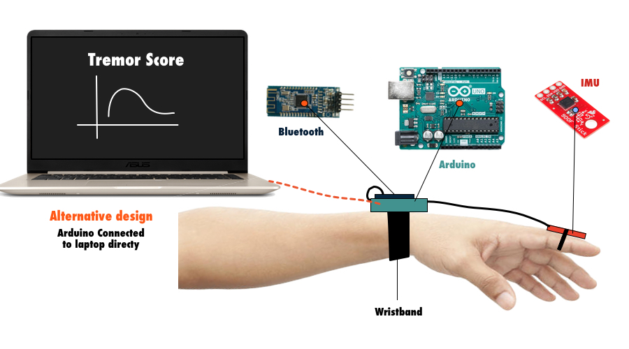
Design Overview: Portable Tremor Recorder
Notes:
Describe the technical design. Include a block diagram. Mention the preferred and alternative designs.

Slide 7
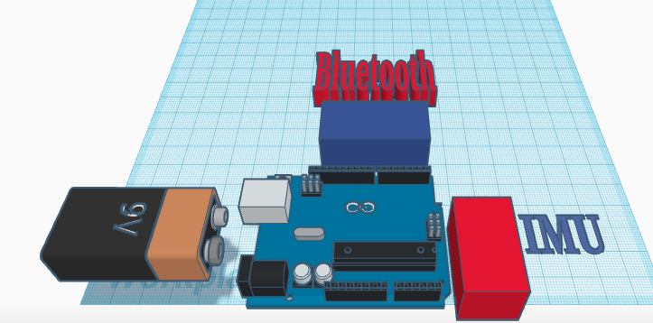
Design Specifications
The Arduino board is powered by a 9V battery.
SparkFun 9DoF Sensor Stick - 3-axis accelerometer, 3-axis gyroscope, and 3-axis magnetometer
Bluetooth - HM-10 4.0 Module
Softwares:
Matlab
Arduino
Applications:
DSD TECH Bluetooth

Slide 8
Test Methodology
The IMU device will be tested on a hand with two different conditions: controlled (no vibration) and a hand experiencing constant vibrations.
To check if the device collected the data properly, the filtered data will be analyzed and plotted and a difference should appear between the two conditions tested with a size relative to the vibration frequency.

Slide 9
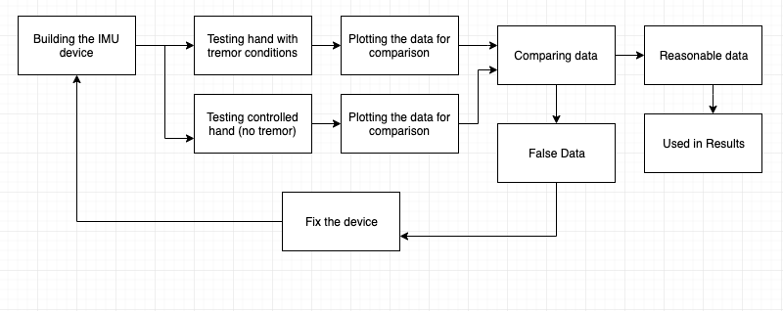
Project Testing Block Diagram

Slide 10
Project Deliverables
Project Proposal
Project specifications
Deliverables
Preliminary design
Budget and part lists
Weekly Group Updates
Planning and design phase
Modeling of the system
Preferred design and alternative design
Project implementation/development
Design review (presentation)
Progress review (presentation)
Initial results (presentation)
Analysis of results.
Design improvements.
Implementation of suggested improvement
Final report and project video
Final presentation and demonstration

Slide 11
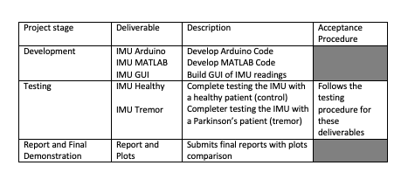
Project Deliverables

Slide 12
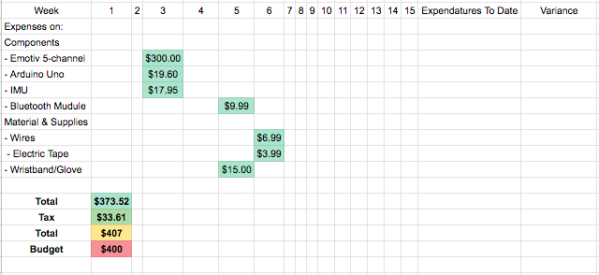
Project Budget

Slide 13
(Remaining) Project Schedule
Task Number | Task | Start Date | Finish Date | Percent Complete (%) | Assigned To
8 | Presenting the initial project | Feb 15th | Feb 15th | 0 | Project Group
9 | Assembling parts and building project | Feb 22nd | Feb 22nd | 0 | Project Group
10 | Testing project hardware | Mar 1st | Mar 1st | 0 | Project Group
11 | Analyzing data collected using MATLAB software | Mar 8th | Mar 8th | 0 | Project Group
12 | Connecting the hardware and software parts with other groups | Mar 15th | Mar 15th | 0 | Project Group
13 | Testing the complete project | Mar 22nd | Mar 22nd | 0 | Project Group
14 | Presenting the finished project | May 3rd | May 3rd | 0 | RoboDocGroup

Slide 14
Questions?

Slide 15
THANK YOU!!

